Slide 1
Cloud Native Apps - Defined
Pravin Y Pawar

Slide 2
Cloud native
Is all about changing the way you think about constructing critical business systems
embracing rapid change, large scale, and resilience
An approach to building and running applications that exploits the advantages of the cloud computing delivery model
Appropriate for both public and private clouds
Is the ability to offer nearly limitless computing power, on-demand, along with modern data and application services
Is about how applications are created and deployed, not where!
The Cloud Native Computing Foundation provides an official definition:
Cloud-native technologies empower organizations to build and run scalable applications in modern, dynamic environments such as public, private, and hybrid clouds. Containers, service meshes, microservices, immutable infrastructure, and declarative APIs exemplify this approach.

Slide 3
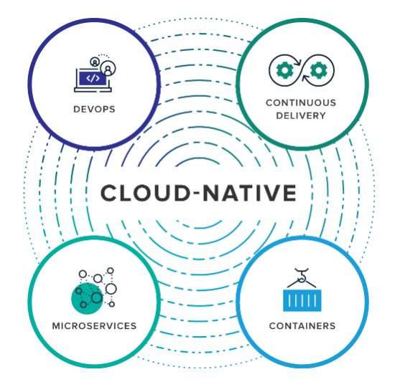
Cloud native Building Blocks
Source : VMWare Blog

Slide 4
Cloud native Building Blocks (2)
DevOps, Continuous Delivery, Microservices & Containers
Microservices
is an architectural approach to developing an application as a collection of small services
each service implements business capabilities, runs in its own process and communicates via HTTP APIs or messaging
Containers
offer both efficiency and speed compared with standard virtual machines (VMs)
Using operating system (OS)-level virtualization, a single OS instance is dynamically divided among one or more isolated containers, each with a unique writable file system and resource quota
Low overhead of creating and destroying containers combined with the high packing density in a single VM makes containers an ideal compute vehicle for deploying individual microservices
DevOps
Collaboration between software developers and IT operations with the goal of constantly delivering high-quality software that solves customer challenges
Creates a culture and an environment where building, testing and releasing software happens rapidly, frequently, and more consistently
Continuous Delivery
is about shipping small batches of software to production constantly, through automation
makes the act of releasing reliable, so organizations can deliver frequently, at less risk, and get feedback faster from end users
Source : VMWare Blog

Slide 5
Containers
"Containers are a great enabler of cloud-native software." - Cornelia Davis
The Cloud Native Computing Foundation places microservice containerization as the first step in their Cloud-Native Trail Map - guidance for enterprises beginning their cloud-native journey.
Cloud Native Trail Map

Slide 6
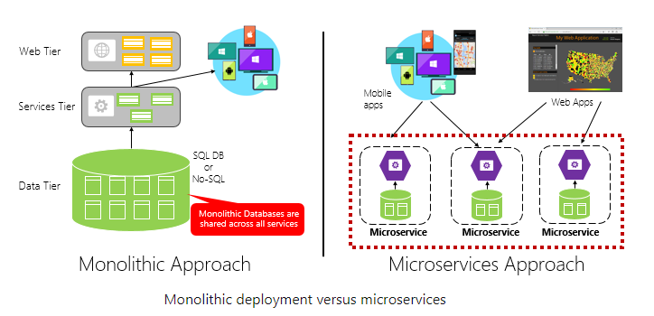
Microservices Architecture
Characteristics
Each implements a specific business capability within a larger domain context
Each is developed autonomously and can be deployed independently
Each is self-contained encapsulating its own data storage technology (SQL, NoSQL) and programming platform
Each runs in its own process and communicates with others
Compose together to form app.
Source : Microsoft

Slide 7
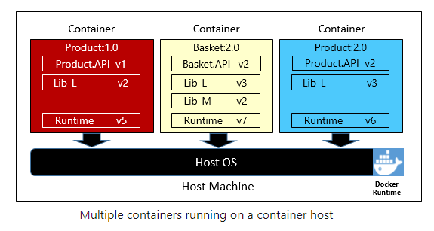
Containerizing a Microservices
Simple and straightforward
The code, its dependencies, and runtime are packaged into a binary called a container image
Images are stored in a container registry, which acts as a repository or library for images
A registry can be located on your development computer, in your data center, or in a public cloud
Docker itself maintains a public registry via Docker Hub
When needed, transform the image into a running container instance
The instance runs on any computer that has a container runtime engine installed
Can have as many instances of the containerized service as needed
Source : Microsoft

Slide 8
Thank You!
In our next session:

